Slide 1

Behavior Trees
Constructed Behavior Systems

Slide 2

Agent Behaviors
A behavior is a way an agent thinks & acts.
Behaviors can be…
Simple (e.g. scripted)
A composition of behaviors
After running a behavior, it will return a status:
Success (completed)
Failure (did not complete)
Running (suspends tree processing to return later)
We should try to give players as much information as possible about the AI’s mind: animation, audio cues, personality, etc.

Slide 3

Decision Trees
Decision trees help agents make decisions (actions) by branching based on aspects of the world (aka knowledge) at a particular time.
Decision Trees…
Ask some question about world / agent
Branch according to possible answers
Terminate in decisions (leaf nodes)
Decision trees can use machine learning
Decision tree models have largely given way to
the more recent Behavior Tree model in games.
Zombie?
Yes
No
Hungry?
Yes
No
Hide
Eat Brains
Moan

Slide 4

Behavior Trees
We can use Behavior Trees to model agent behaviors.
Behavior Types and Examples:
Primitives
  Conditions
  Actions
Decorators
  Loop
  Wait
  Invert
Composites
  Sequences
  Selectors
  Parallels

Slide 5


Conditions & Actions
Conditions and actions are the most basic behaviors.
Conditions check the status of something in the world.
Are enemies nearby?
Is the character attacking?
Do I have a key?
Actions do something that alters the world in some way.
Grab pick-axe
Push block to the left
Eat a sandwich

Slide 6
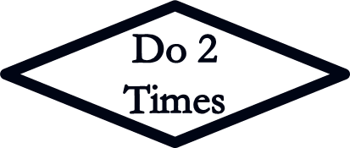

Decorators
A decorator adds flexibility or control to an action without modifying that action’s code.
Some decorator types:
Loop
Retry
Inverter
Counter
Timer
Debug Node
Guard (semaphore)

Slide 7




Sequences
A sequence is a set of behaviors all of which must complete for the sequence to succeed.
If any child fails, the sequence immediately fails.
F
S
S
S
S
F
F
F

Slide 8




Selectors
A selector is a set of behaviors any one of which must complete for the selector to succeed. They are normally picked from left to right, but can also use priorities or randomness.
If any child succeeds, the selector immediately succeeds.
S
F
F
F
F
S
S
S

Slide 9

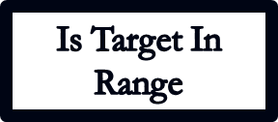

Selectors
A selector can be used to model an if statement.
S
//Equivalent pseudo-code
if(!isTargetInRange())
BeginApproachBehavior();
F
F
S
…

Slide 10


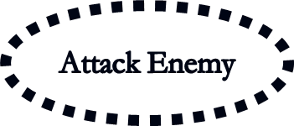

Selectors
A selector can be used to model an if statement.
S
//Equivalent pseudo-code
if(!isTargetInRange())
BeginApproachBehavior();
else
BeginAttackBehavior();
F
F
S
…
…

Slide 11



Parallels
A parallel is a set of behaviors which all run simultaneously (in theory – this can be faked). A policy defines success or failure in a parallel. If a parallel succeeds/fails, any children still running must also be terminated.
This example mostly mimics a sequence:
S
F
S
S
S
F
F
F

Slide 12










Behavior Tree Example
Starting with the root behavior, behaviors are chosen until one returns a running status, or the entire tree succeeds/fails. Yellow arrows indicate order of evaluation.
Sequence-like
parallel
= compound task
= decorator
= action
= condition

Slide 13
Behavior Tree Example – Run 1
In the first traversal, the player is seen, but finding ammo will take more than one tick.
= visiting
= succeeded
= failed
= running
= compound task
= decorator
= action
= condition

Slide 14

Behavior Tree Example – Run 2
In the second traversal, we resume at the running node and later succeed in shooting the player.
= visiting
= succeeded
= failed
= running
= compound task
= decorator
= action
= condition

Slide 15
Behavior Tree Example – Run 3
In the third traversal, the player is not seen. We try to patrol but fail at walking, so the patrol fails.
= visiting
= succeeded
= failed/aborted
= running
= compound task
= decorator
= action
= condition

Slide 16

Behavior Trees
Benefits & Drawbacks
Benefits
Easy to understand and control
Fast run-time execution
Can be built and tweaked rapidly, especially with graphical tools
Flexible and scalable; complexity of trees can be scaled up and down as needed, and subtrees can be reused easily
Drawbacks
Basically reactive so no real plan or states (good conditions can help)
Naïve version only evaluates in left-to-right order (but priorities, costs, and chances can be added)
Naive version also always traverses from root, using up CPU time (event-driven trees can fix this)
Slow to respond to urgent events (try monitor-style parallels)

